Slide 1

PI and Thermal Simulation Study for BD9D321EFJ Board
October 03rd, 2014
Hosted by: Xuan Dang

Slide 2
Agenda
Introduction
DC Drop Analysis
Current Density Analysis
Thermal Analysis
Conclusion

Slide 3
Introduction
This work considers power simulation and thermal simulation on BD9D321EFJ boards.
Based on board file BD9D321EFJ-E2EVK-101_BRD_REV00_2014-09-29.brd
PowerDC software is used for simulation
PI simulation considers:
DC Drop analysis
Determine what the max drop for power rail
Current Density analysis
Determine the hot spot of current density on PCB
Thermal simulation considers:
PCB temperature profile including consideration for conductive, radiative, and convective heat transfer

Slide 4
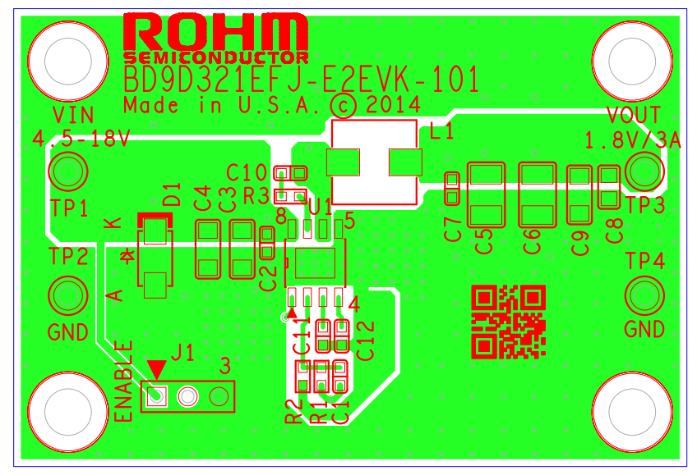
BD9D321EFJ Board
Based on the board file : BD9D321EFJ-E2EVK-101_BRD_REV00_2014-09-29.brd

Slide 5
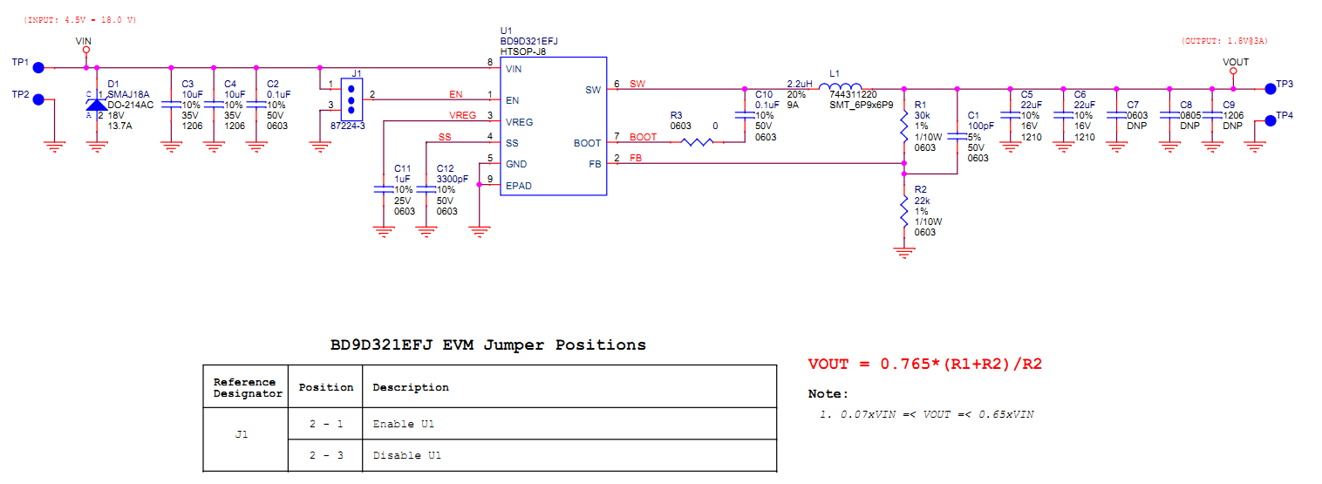
BD9D321EFJ Schematic
Based on the schematic file : BD9D321EFJ-E2EVK-101_SCH_REV00_2014-09-26.pdf

Slide 6
BD9D321EFJ Board power consumption
Device/rail | Source/VRM refdes | Source PCB netname | Sink/load PCB refdes | Load PCB net name | Nominal Voltage(V) | Voltage tolerance (%) | Max current (A) | Power input (W) | Power consumption (W) | Note
Power input via TP1/TP2 connectors (VIN 4.5-18V) | TP1 | VIN | U1 | VIN | 4.5 |  | 2 | 9.0 |  | Max input current = (Pout + PONH + PONL + PL)/VIN = 1.55A with Vin= 4.5 V. So we choose max input current = 2A to simulate power/thermal
Power dissipation on BD9D321EFJ internal FETs | TP1 | VIN | U1 | VIN | 4.125 |  | 3 |  | 1.476 | RONH = 0.2 Ohm; RONL = 0.14 Ohm
Power dissipation on inductor L1 | U1 | SW | L1 | SW |  |  | 3 |  | 0.1026 | RL = 0.0114 Ohm
Power consumption at load via connector TP3/TP4 (VOUT 1.8V) | L1 | SW | TP3 | VOUT | 1.8 | 2 | 3 |  | 5.4
 |  |  |  |  |  |  | Total | 9.0 | 6.9786

Slide 7
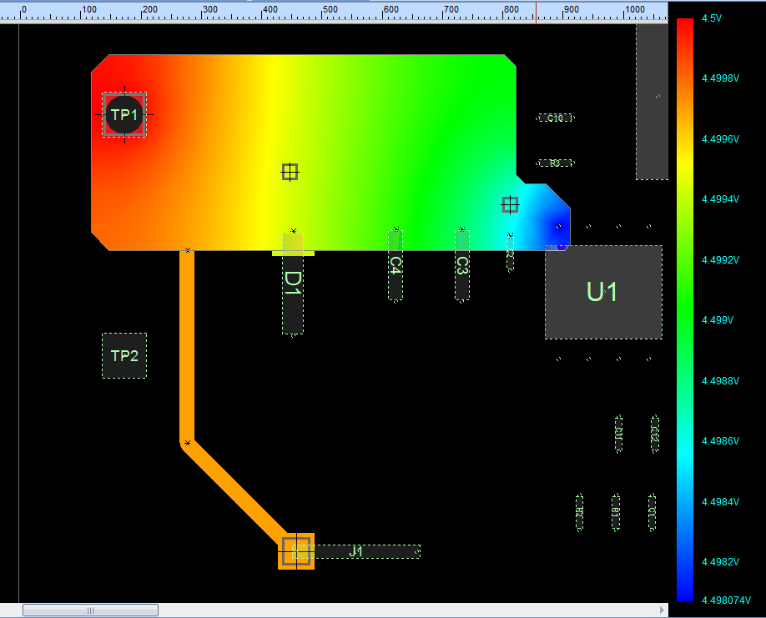
DC Drop analysis for VIN 4.5V@2A at TOP Layer
Source TP1
Load U1
Max DC Drop 1.93mV < 90 mV (2% tolerance of 4.5V) → Copper planes for VIN is OK

Slide 8
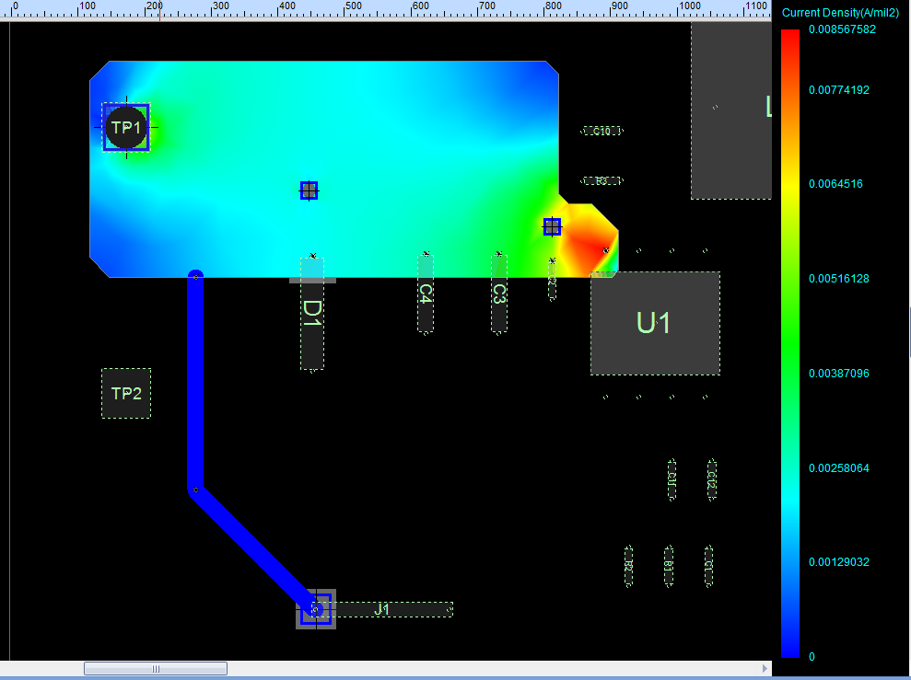
Current Density analysis for VIN 4.5V@2A at TOP Layer
Source TP1
Load U1
Max Current Density 8.57mA/mil²<40mA/mil² (This rule limit 10 Celsius degree of temperature rise above ambient) → Copper plane for VIN is OK

Slide 9
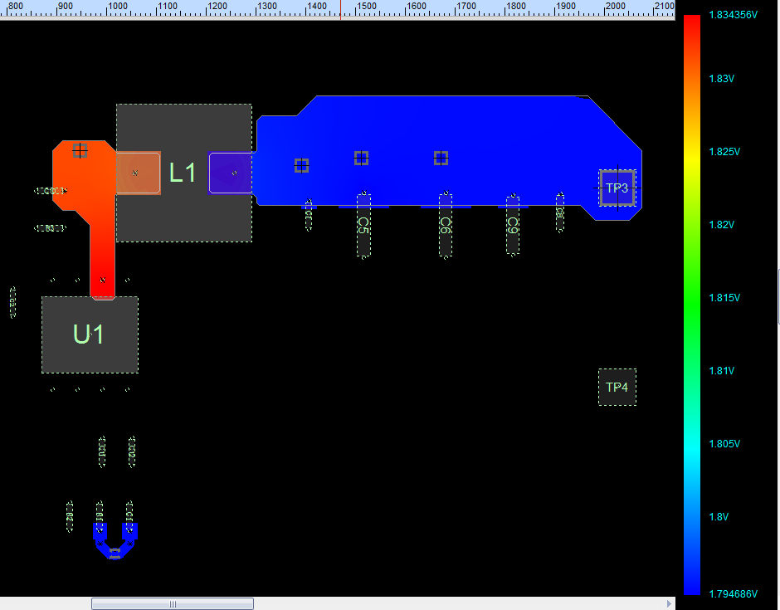
DC Drop analysis for VOUT@3A at TOP layer
Source L1
Load TP3
Max DC Drop 5.3mV < 36mV (2% tolerance of 1.8V) → Copper planes for VOUT is OK

Slide 10
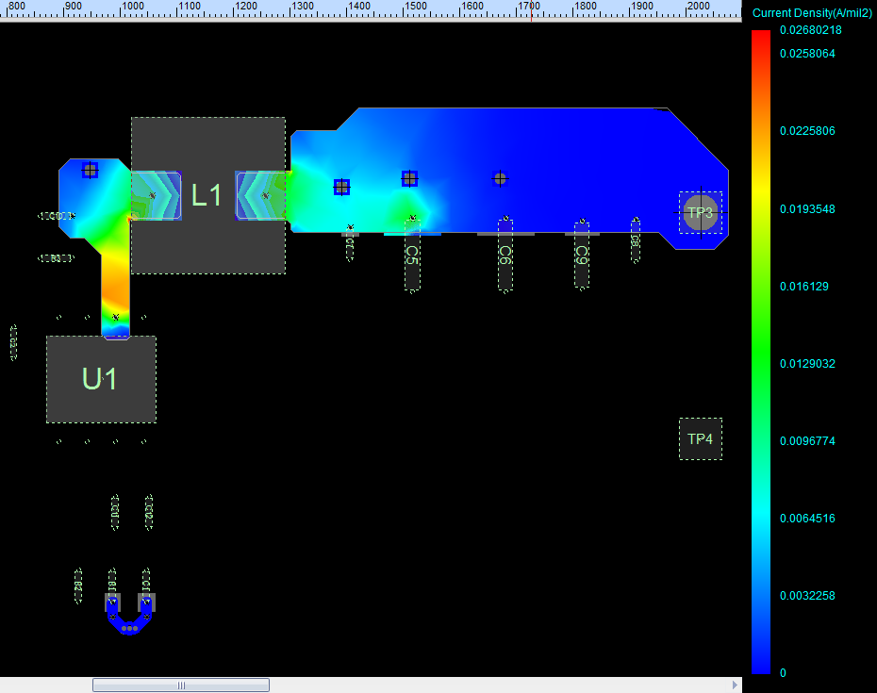
Current Density analysis for VOUT@3A at TOP layer
Source L1
Load TP3
Max Current Density 26.8mA/mil²<40mA/mil² (This rule limit 10 Celsius degree of temperature rise above ambient) → Copper plane for VIN is OK

Slide 11
Thermal Analysis
Environment conditions
Air Temperature : 25 ⁰C , 35 ⁰C and 45 ⁰C
No incoming air flow (Natural convection)
VOUT 20mV/div (AC)
SW 5V/div

Slide 12
Thermal Analysis (Con’t)
Component properties
 | BD9D321EFJ (U1) | 744311220 (L1)
Number of pins | 9 | 2
Max. power dissipation | 1.476 W (at VIN=4.5V) | 0.1026 W
VOUT 20mV/div (AC)
SW 5V/div

Slide 13
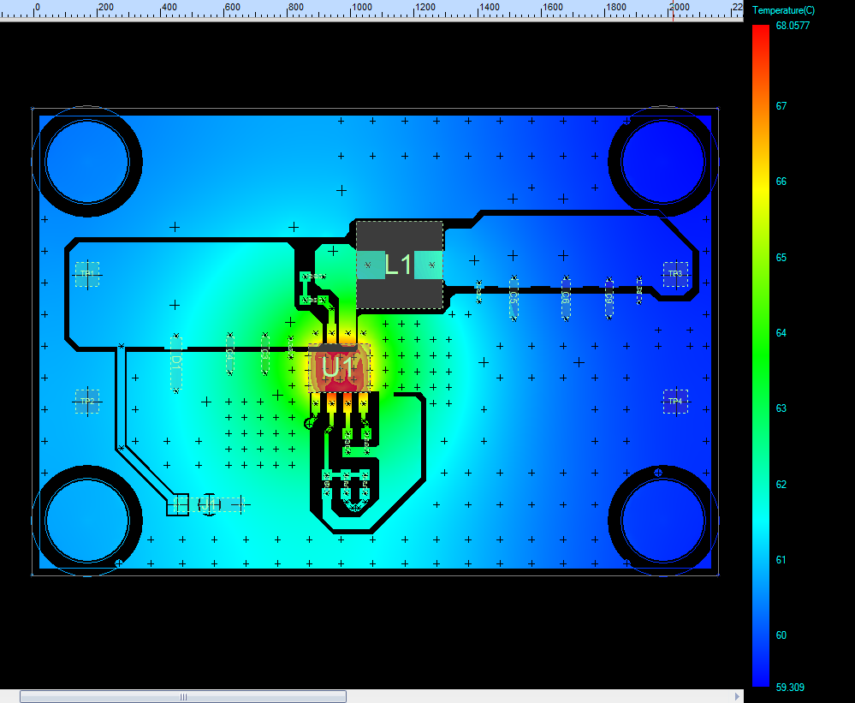
Thermal Analysis (Con’t)
Air temperature 25⁰C, power dissipation of BD9D321EFJ is 1.476 W (at VIN=4.5V)
U1: BD9D321EFJ
Max. power dissipation: 0.1476 W @VIN=4.5V
Component temperature = 68.06 ⁰C
L1: 744311220
Max. power dissipation: 0.1026 W
Component temperature = 62.46 ⁰C
The highest temperature on board is about 68.06 ⁰C
The highest temperature on component is on BD9D321EFJ( about 68.06 ⁰C)

Slide 14
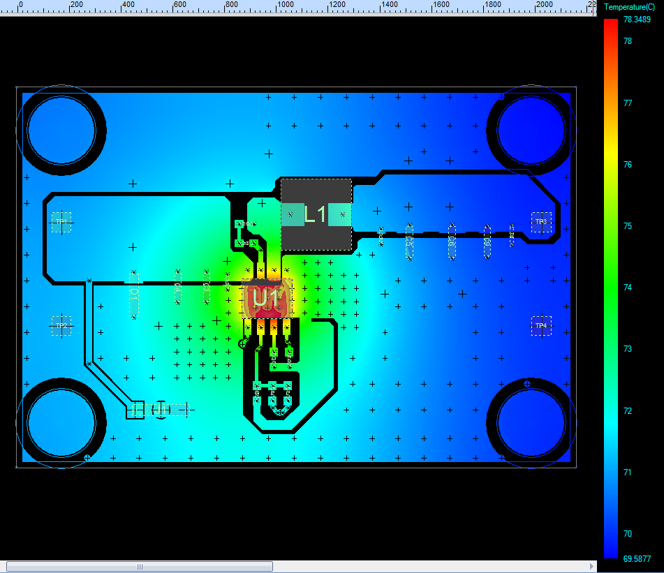
Thermal Analysis (Con’t)
Air temperature 35⁰C, power dissipation of BD9D321EFJ is 1.476 W (at VIN=4.5V)
U1: BD9D321EFJ
Max. power dissipation: 1.476 W @VIN=4.5V
Component temperature = 78.35 ⁰C
L1: 744311220
Max. power dissipation: 0.1026 W
Component temperature = 72.65 ⁰C
The highest temperature on board is about 78.35 ⁰C
The highest temperature on component is on BD9D321EFJ ( about 78.35 ⁰C)

Slide 15
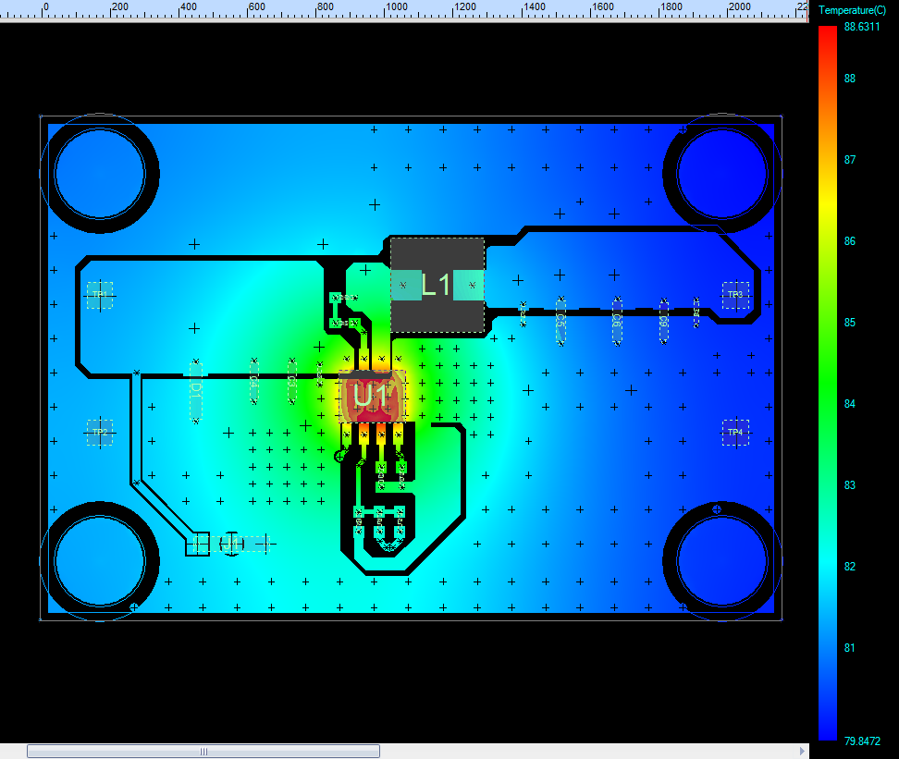
Thermal Analysis (Con’t)
Air temperature 45⁰C, power dissipation of BD9D321EFJ is 1.476 W (at VIN=4.5V)
U1: BD9D321EFJ
Max. power dissipation: 1.476 W @VIN=4.5V
Component temperature = 88.63 ⁰C
L1: 744311220
Max. power dissipation: 0.1026 W
Component temperature = 82.96 ⁰C
The highest temperature on board is about 88.63 ⁰C
The highest temperature on component is on BD9D321EFJ ( about 88.63 ⁰C)

Slide 16
Summary
The PI simulation shows that the max. amount voltage drop of VIN power is 1.93mV, the max. current density of VIN power is 8.57mA/mil²; the max. amount voltage drop of VOUT power is 5.3mV, the max. current density of VOUT power is 26.8mA/mil²
The highest temperature of BD9D321EFJ-E2EVK-101 board can be reached temperature as table below:
 | VIN=4.5V
Air temperature: 25⁰C | 68.06 ⁰C
Air temperature: 35⁰C | 78.35 ⁰C
Air temperature: 45⁰C | 88.63 ⁰C

